Slide 1
Co2 Emission Prediction

Slide 2
Major Learning from the project
Understanding how to handle variable with lot of categories
Learnt one hot encoding using user defined function
Exploratory Data Analysis
Analysing top 10 categories

Slide 3
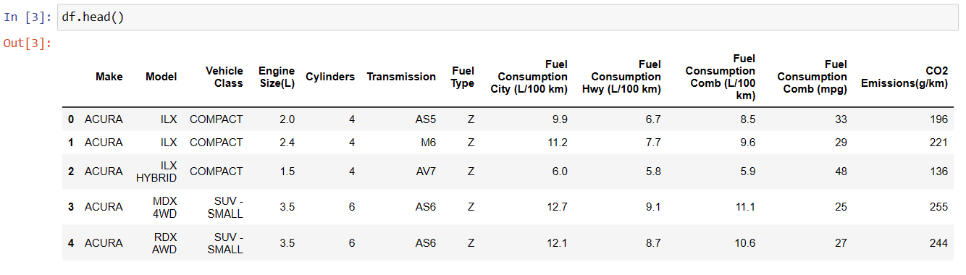

Slide 4
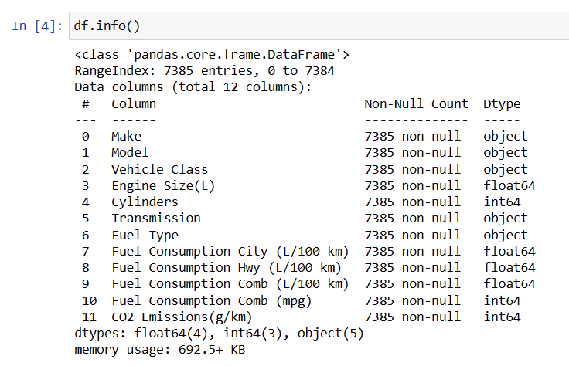

Slide 5
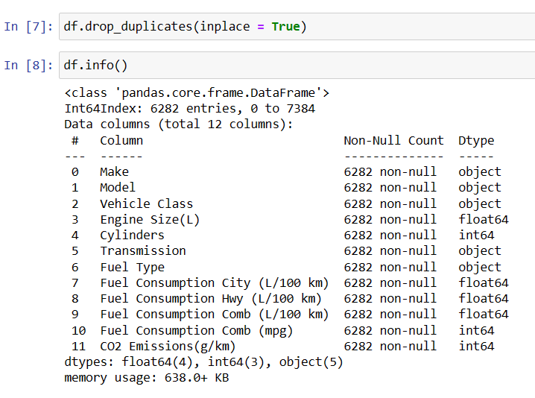

Slide 6
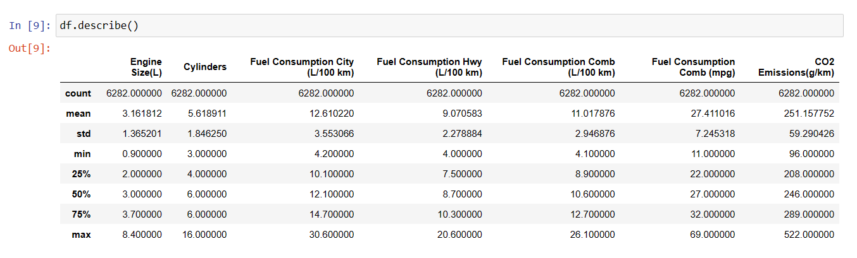

Slide 7
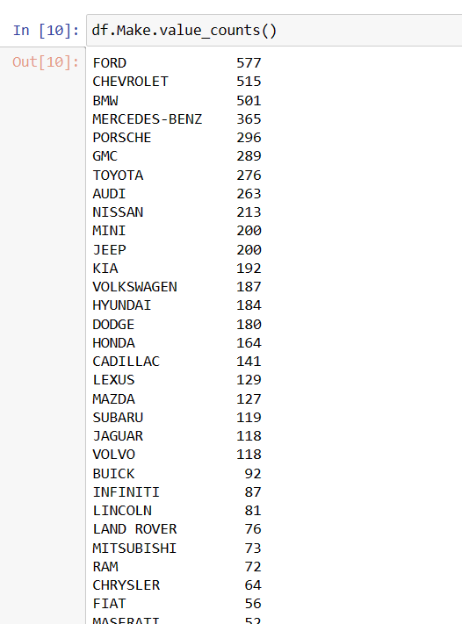
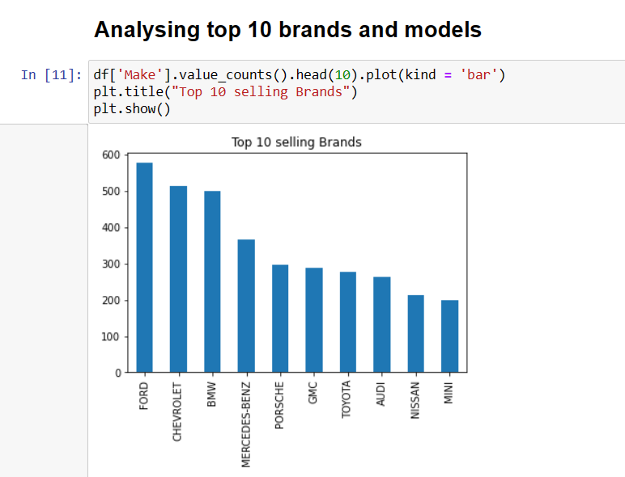

Slide 8
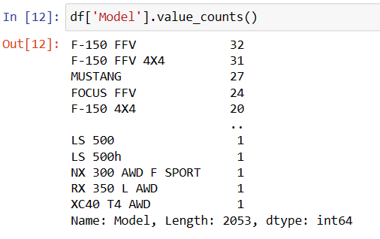
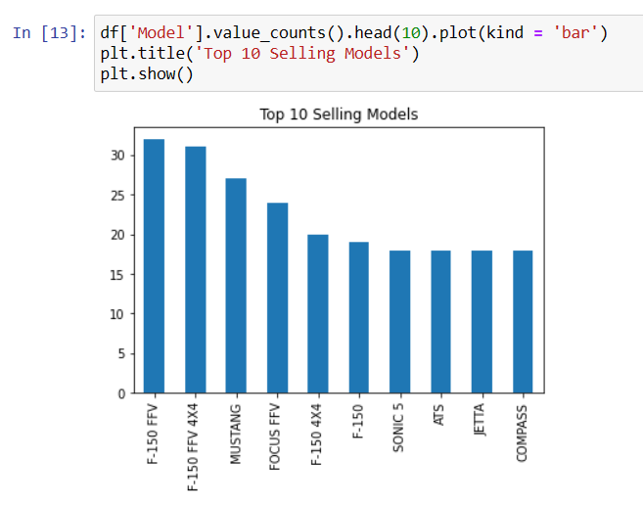

Slide 9
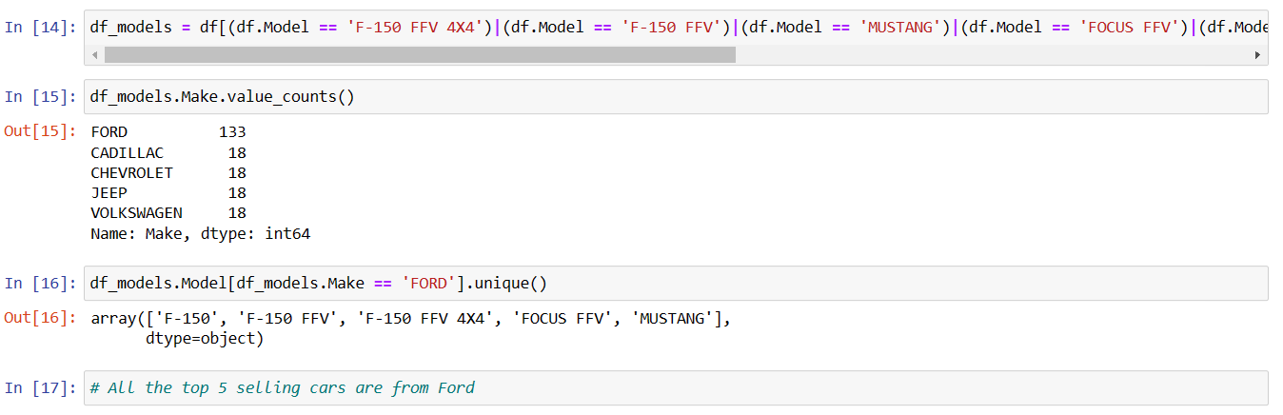

Slide 10
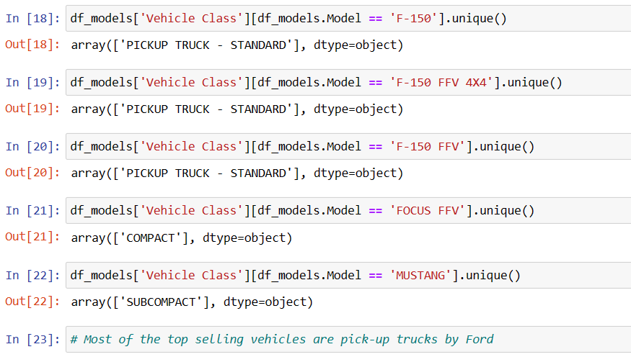

Slide 11
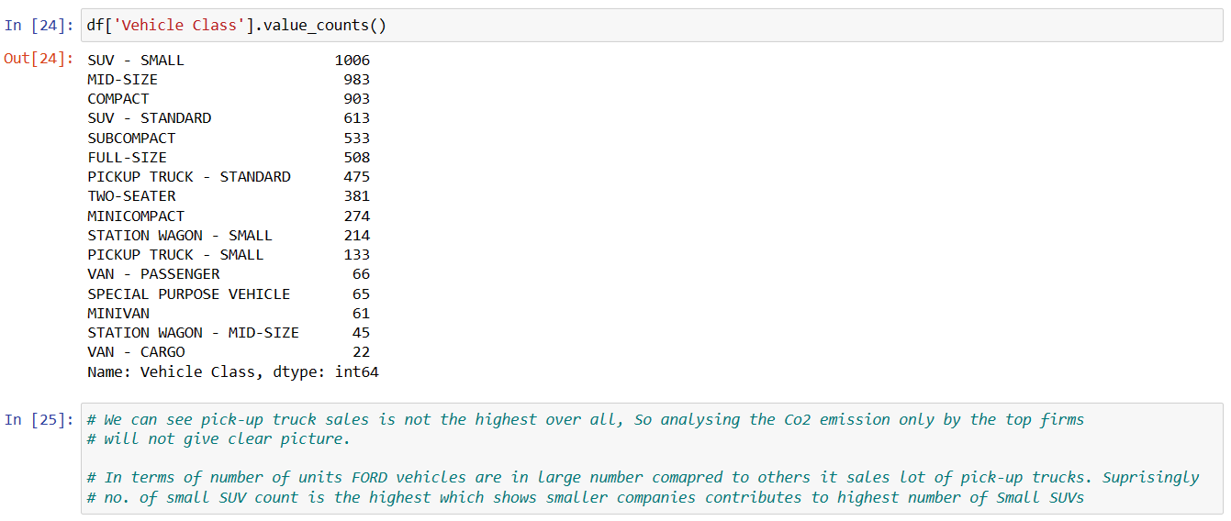

Slide 12
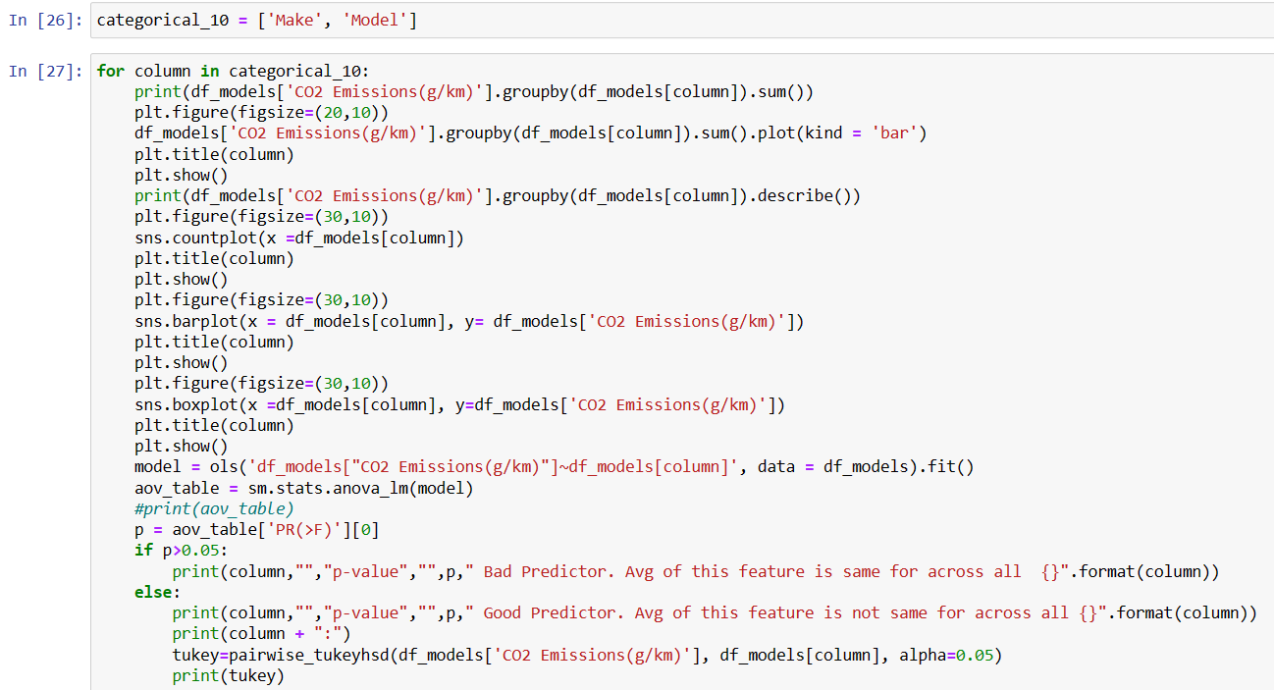

Slide 13
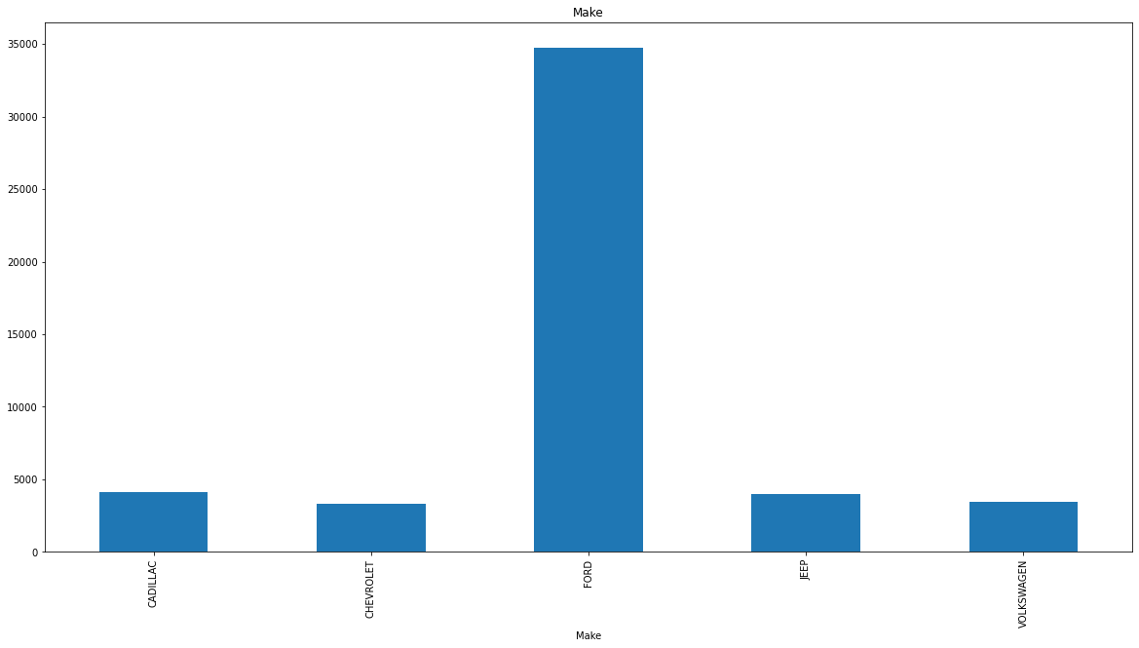
Make CADILLAC 4097 CHEVROLET 3338 FORD 34756 JEEP 3997 VOLKSWAGEN 3470 Name: Total CO2 Emissions(g/km)

Slide 14
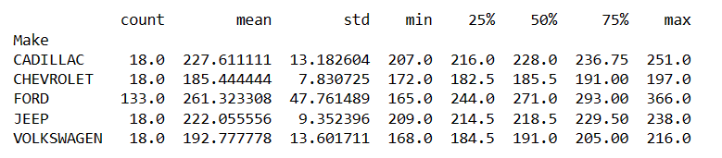
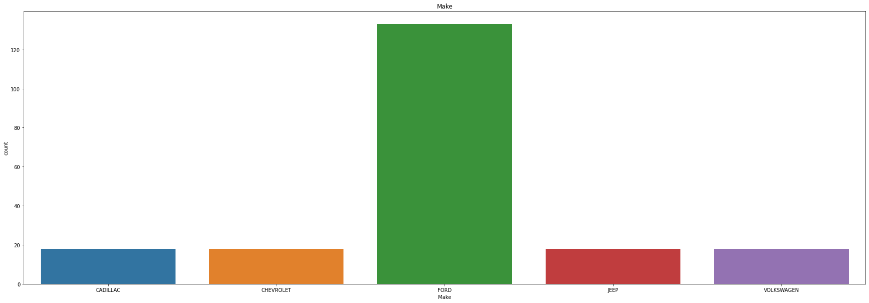

Slide 15
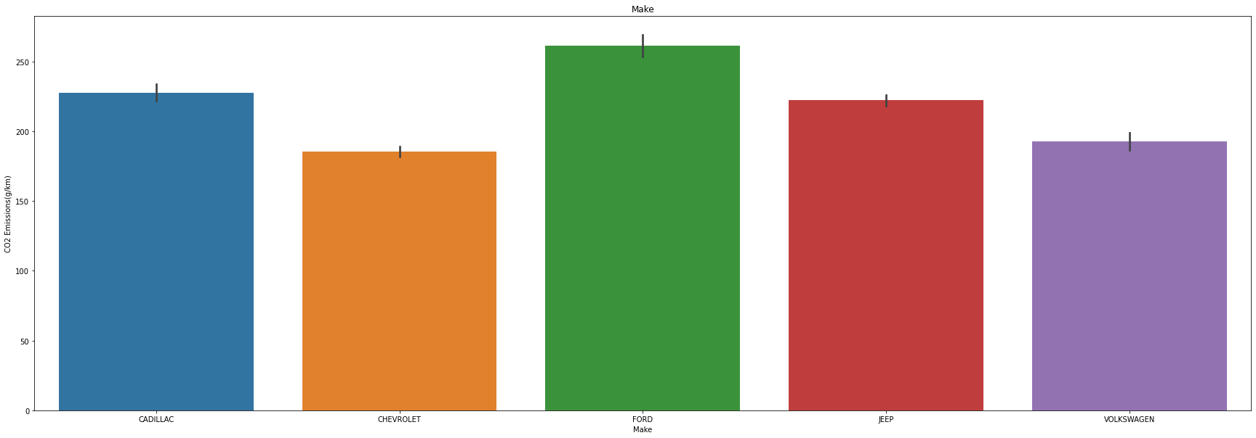
Avg. Co2 Emission

Slide 16
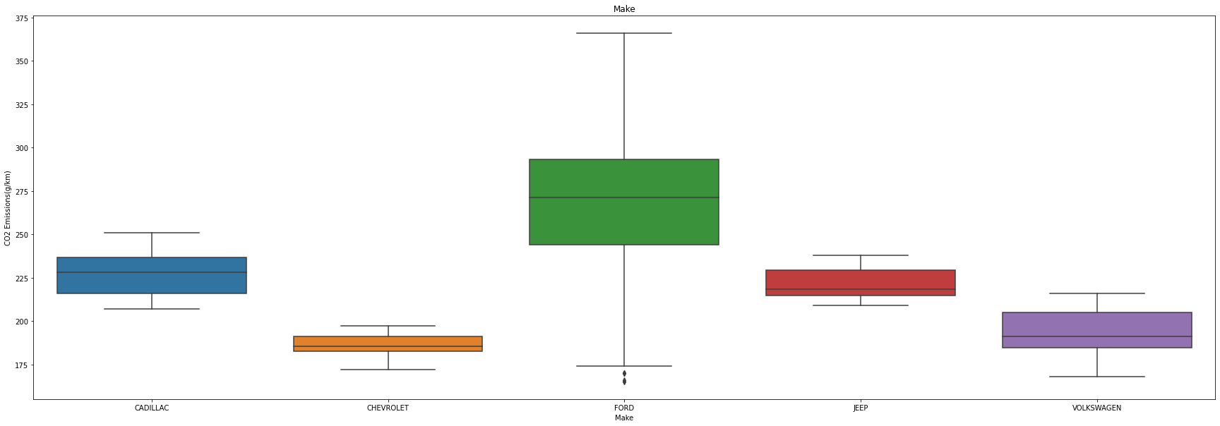
Avg. Co2 Emission

Slide 17
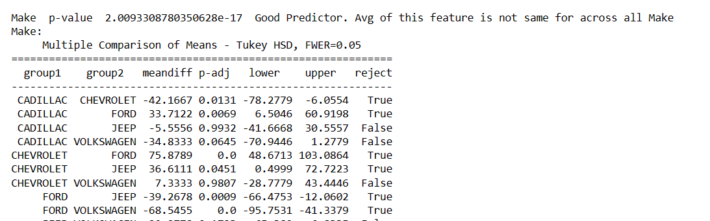

Slide 18
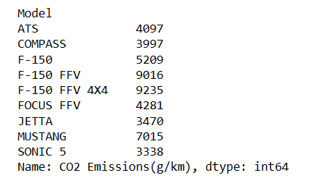
Total Co2 Emission by Car Models

Slide 19
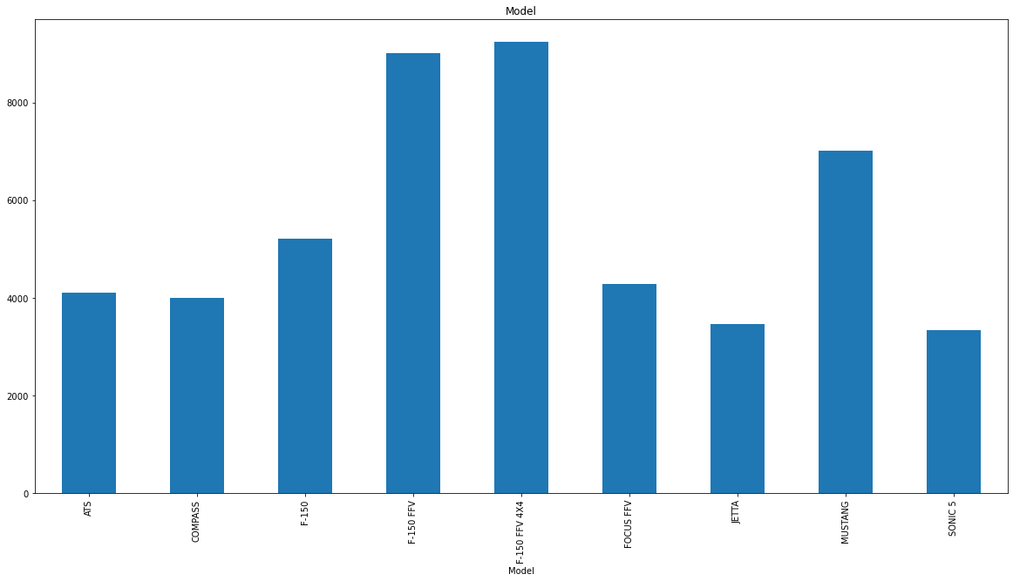

Slide 20
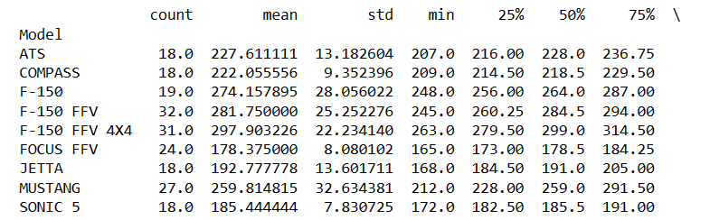
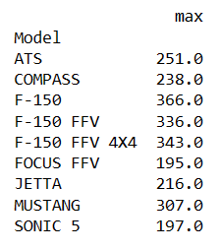

Slide 21
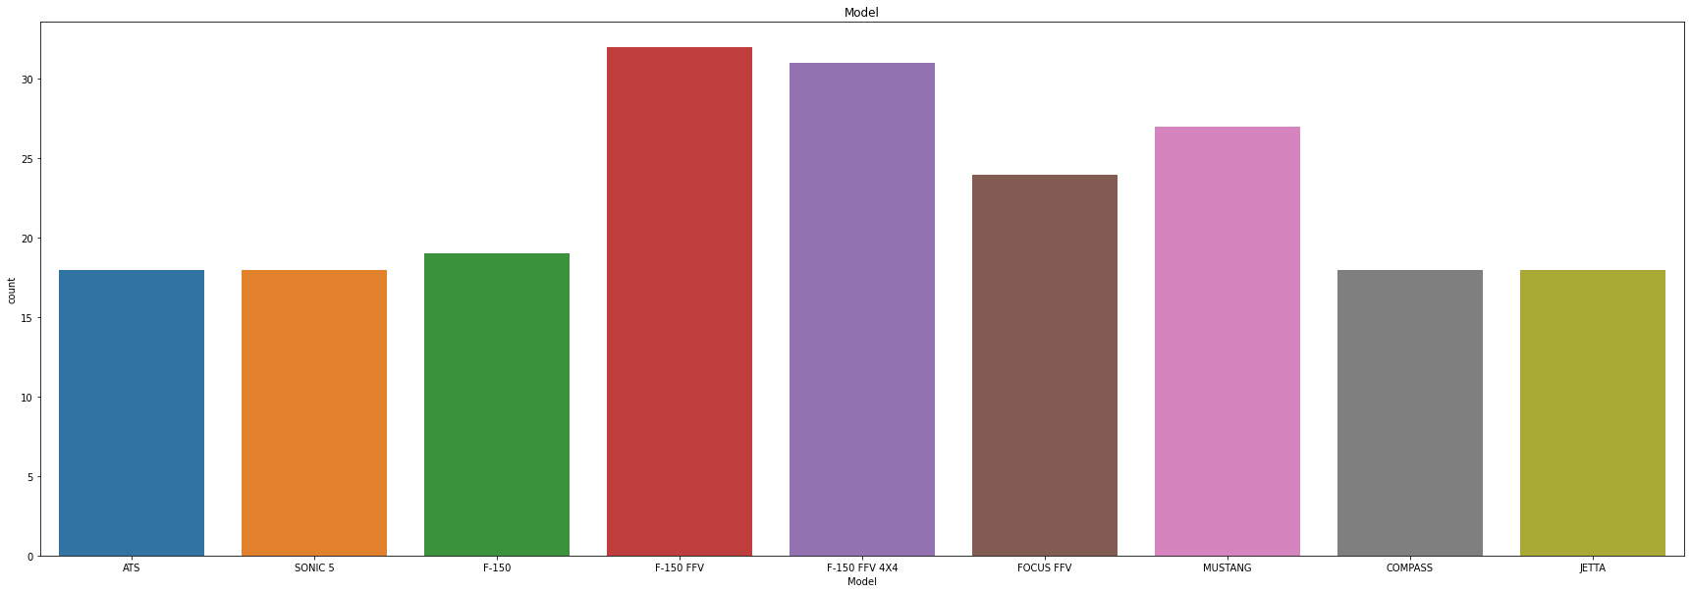

Slide 22
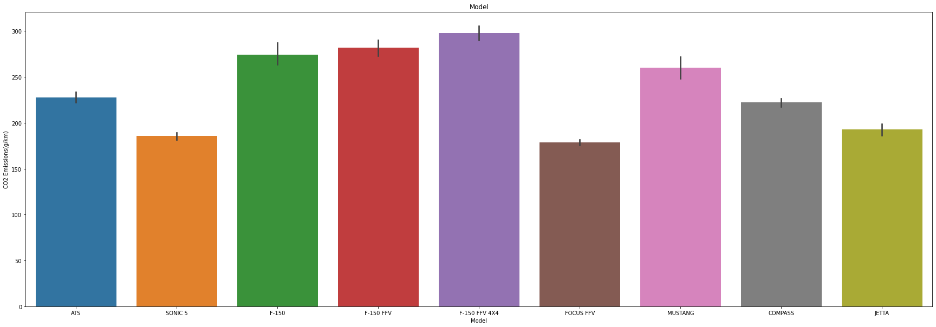

Slide 23
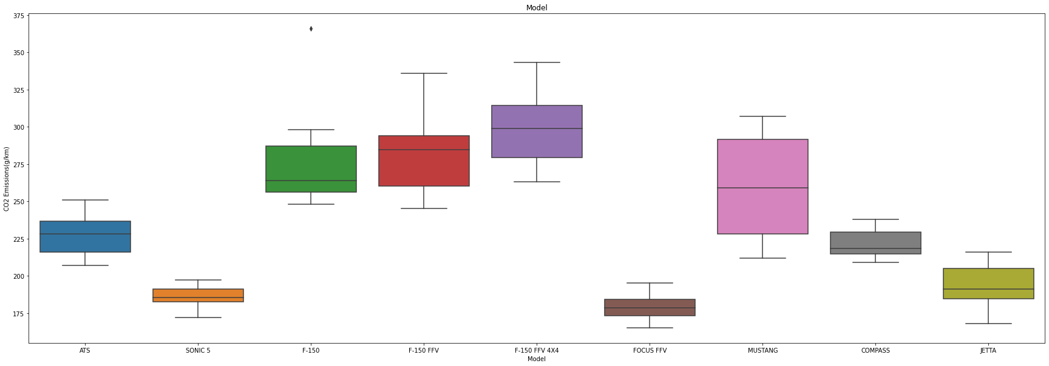

Slide 24
# Make
# Count of Ford is significantly higher so overall Co2 Emission by Ford is also higher
# From bargraph and boxplot we can see, Avg. Co2 Emission by by the top 10 brands is also having a small range, Slight deviation is present because of the mix of class
# of vehicles sold by the brands
# Model
# F-150 FFV, F-150 FFV 4X4, Mustang is having highest Co2 Emission in total
# Similar pattern in countplot justifies the same.
# Jetta, Focus FFV, Sonic 5 have less Co2 emission compared to other models

Slide 25
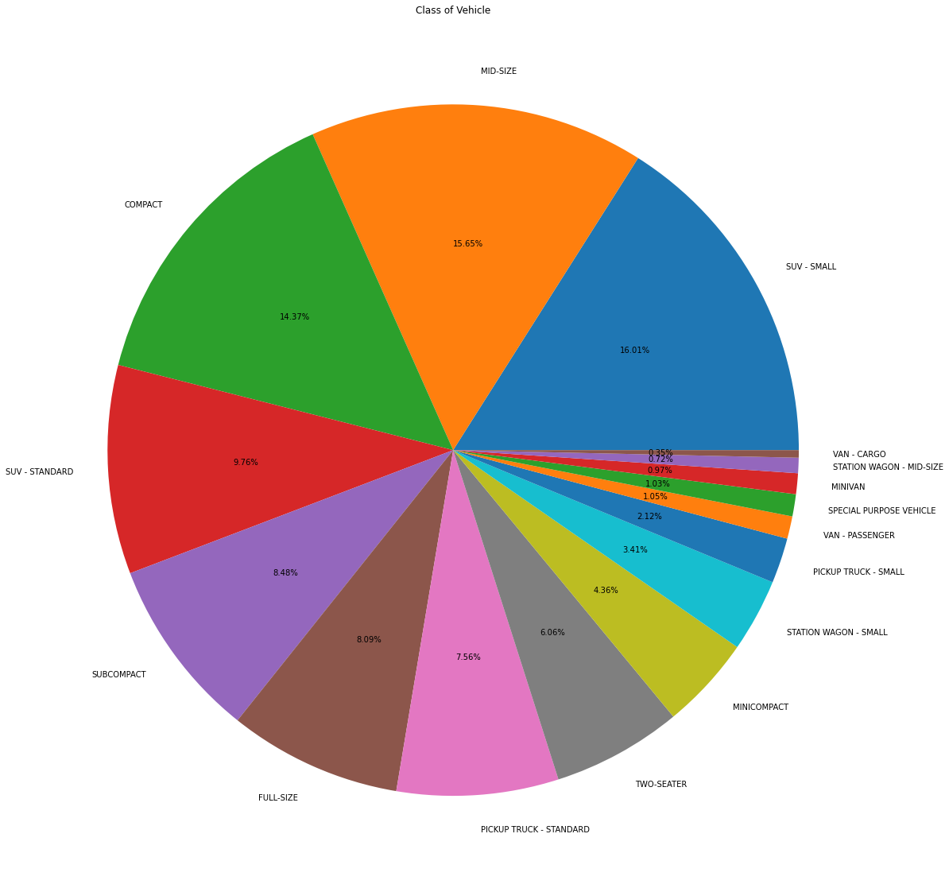

Slide 26
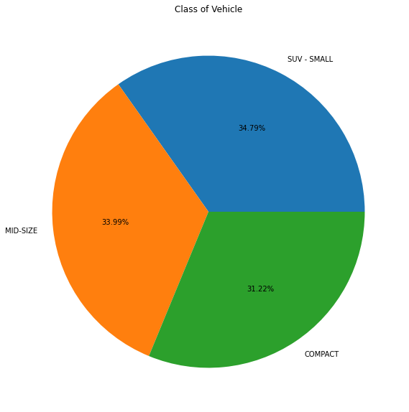
# Cars that are sold majorly are Small SUV, Mid Size and Compact Cars

Slide 27
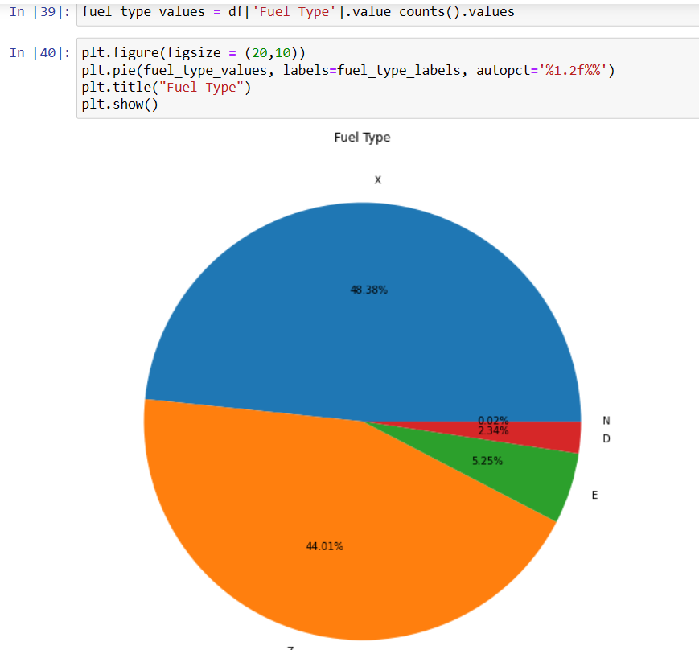
# X and Z are the major fuel type sold

Slide 28
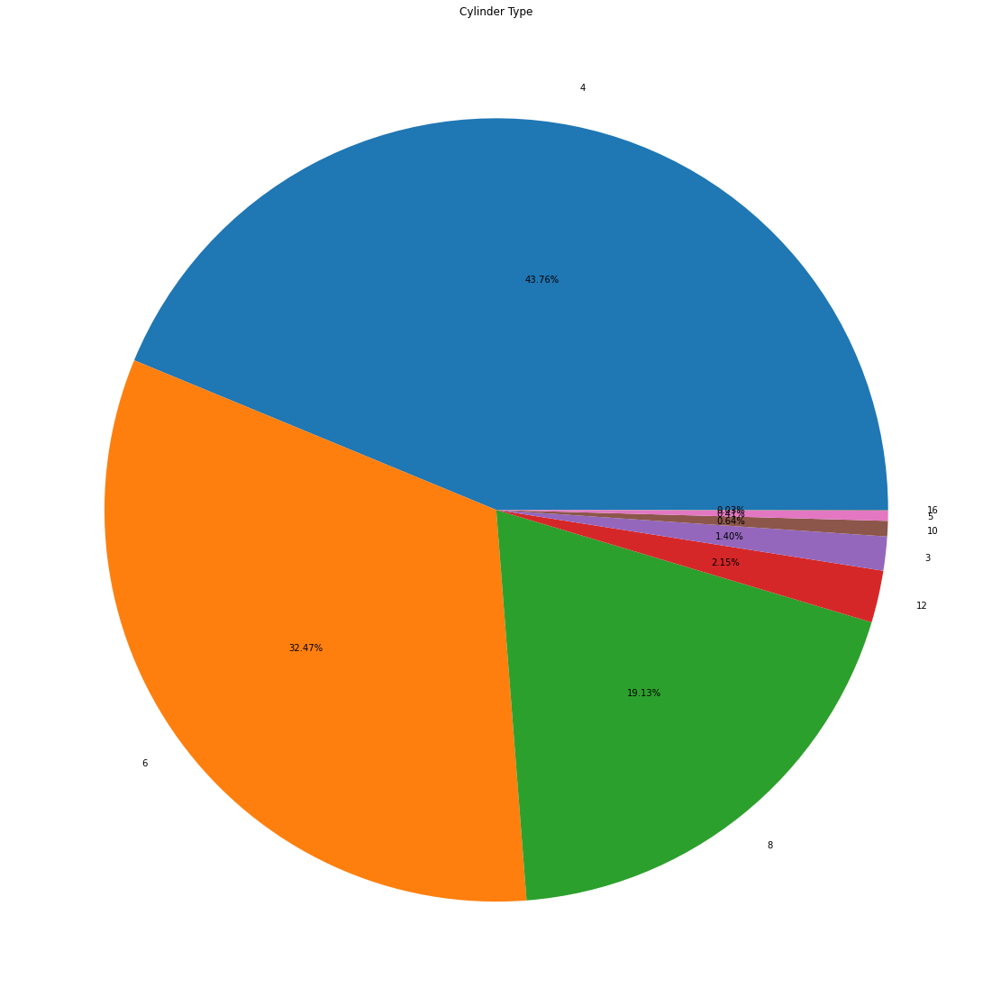

Slide 29
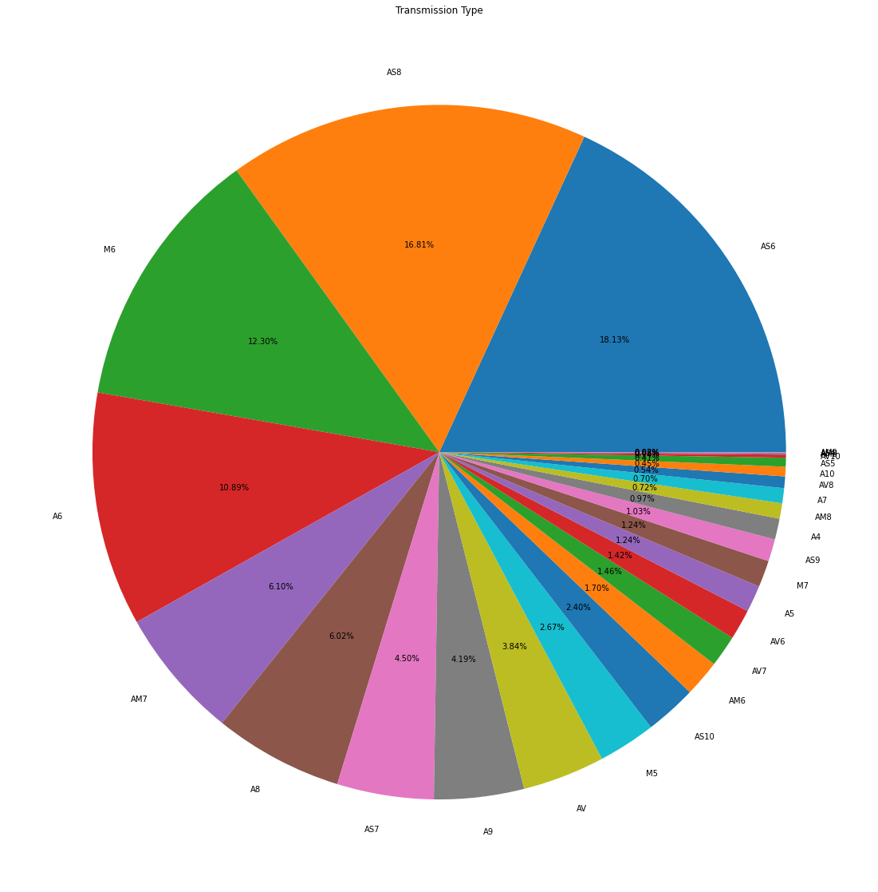

Slide 30
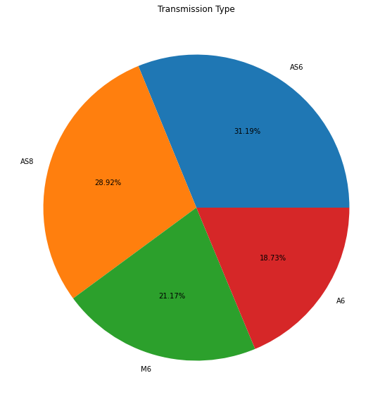

Slide 31
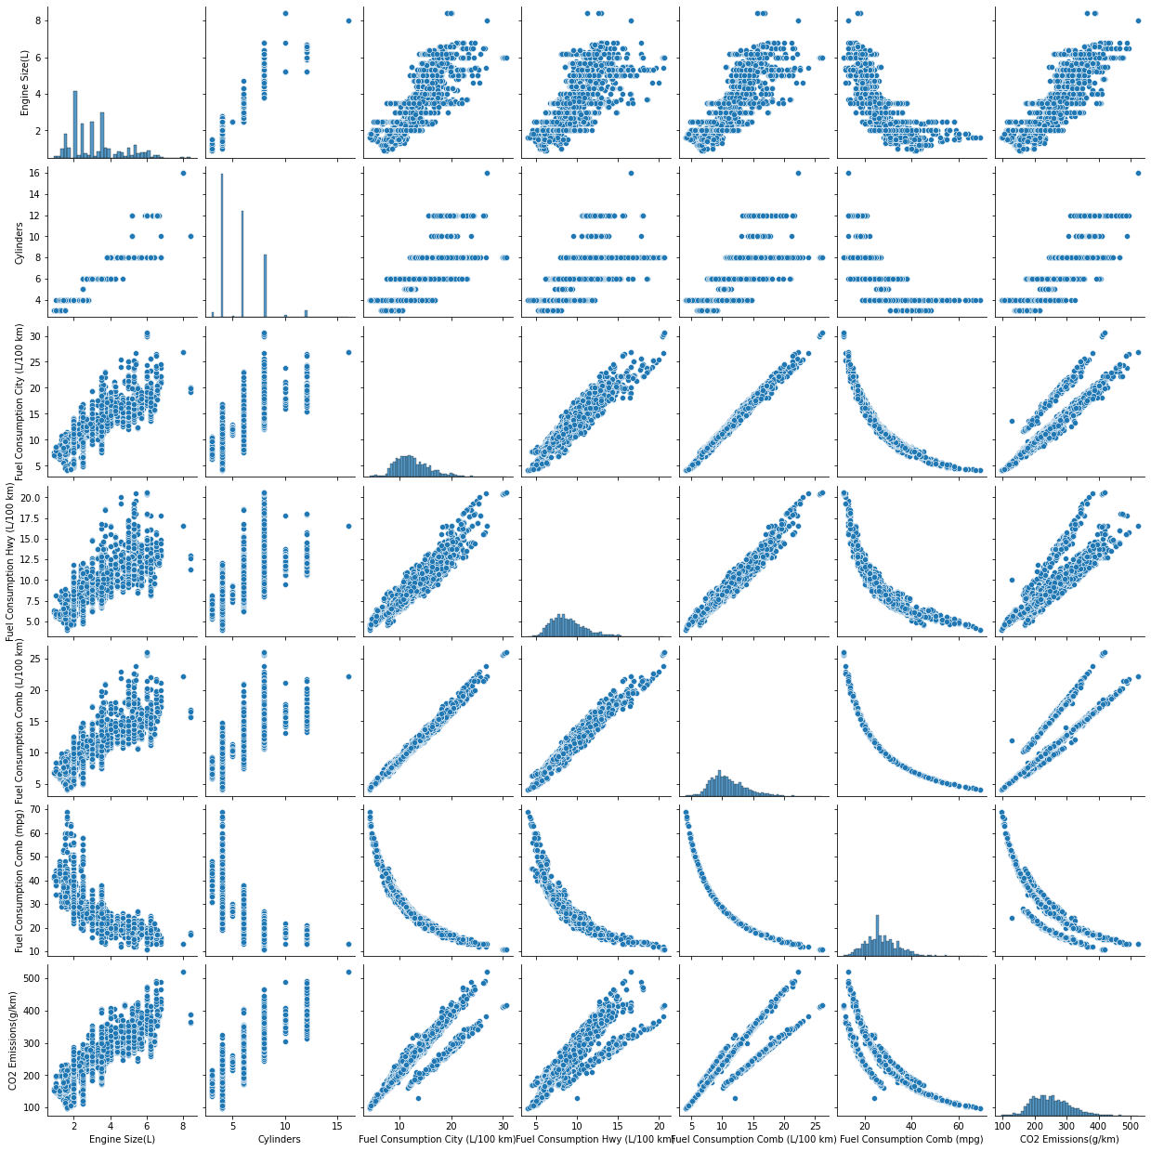

Slide 32
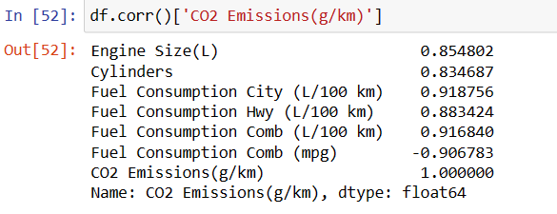
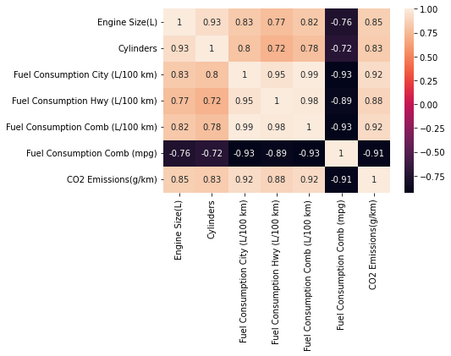

Slide 33
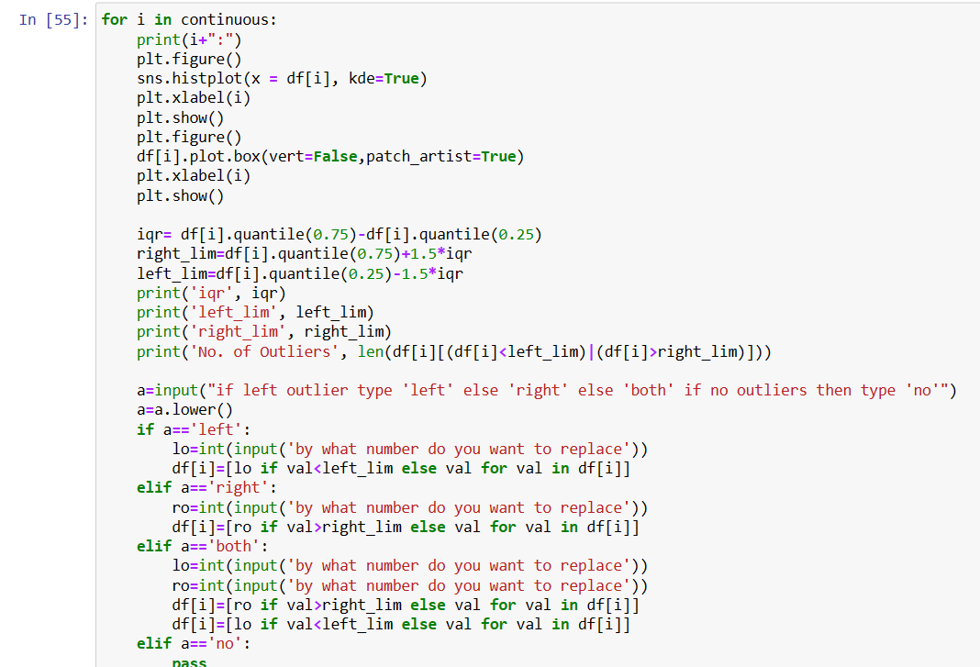


Slide 34
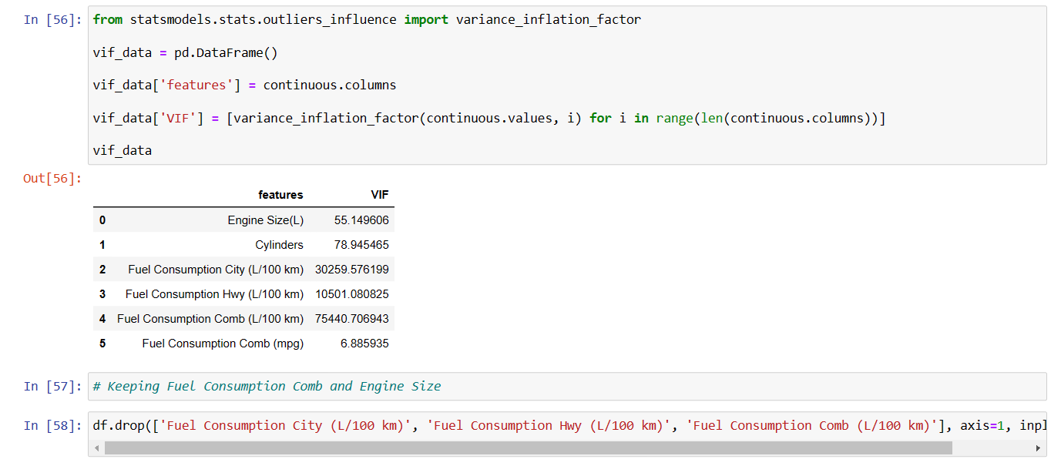

Slide 35
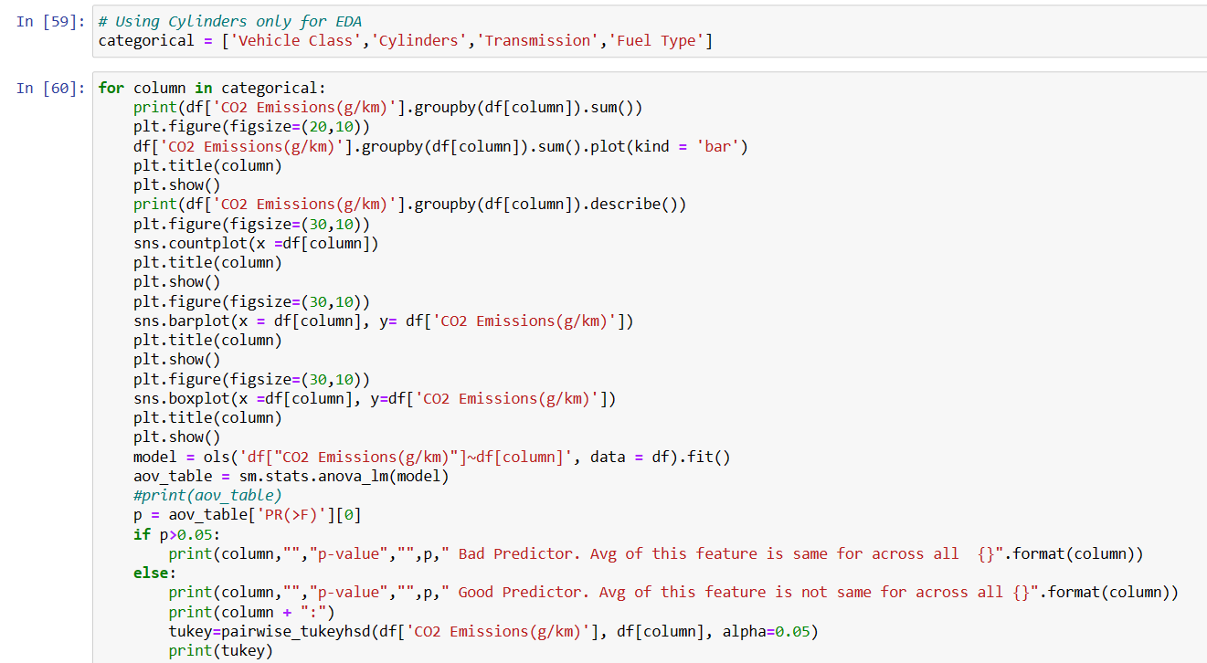

Slide 36
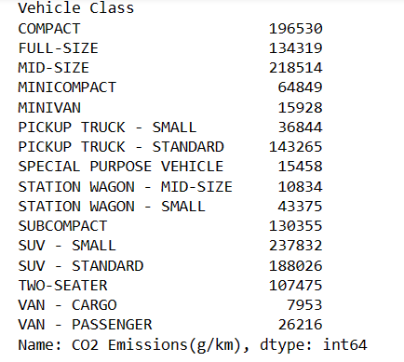
Total Co2 Emission by Vehicle Class

Slide 37
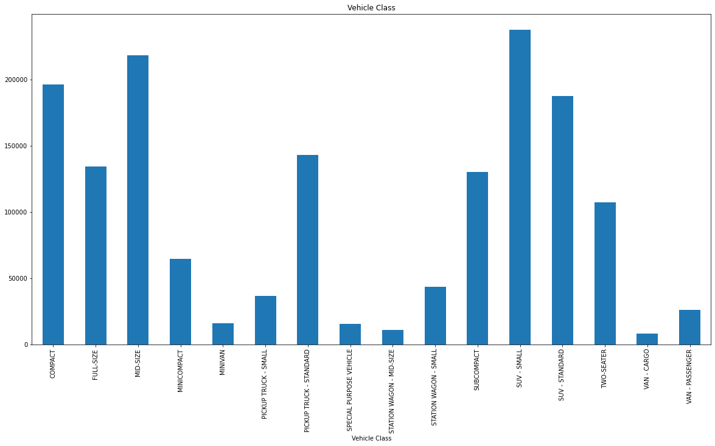

Slide 38
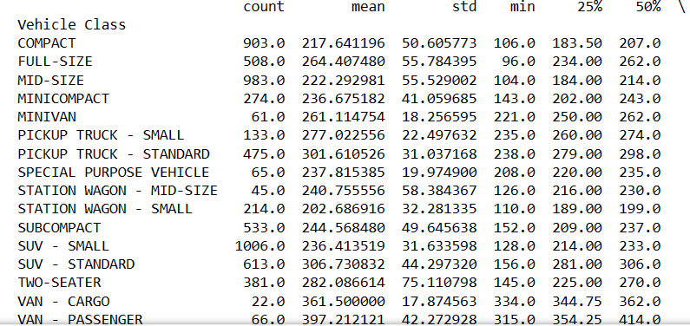
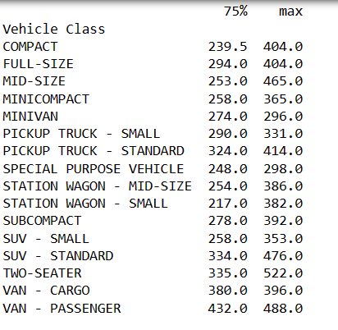

Slide 39
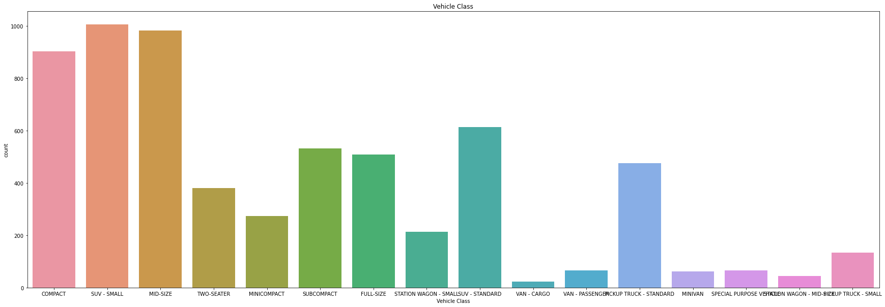

Slide 40
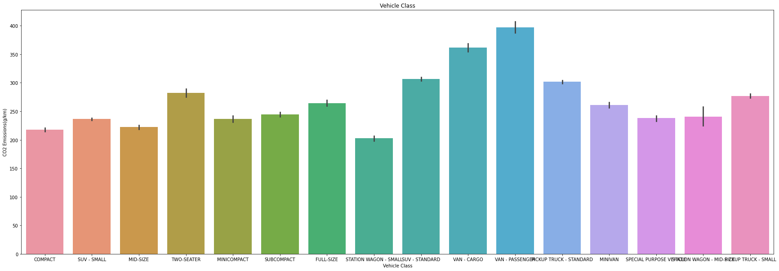

Slide 41
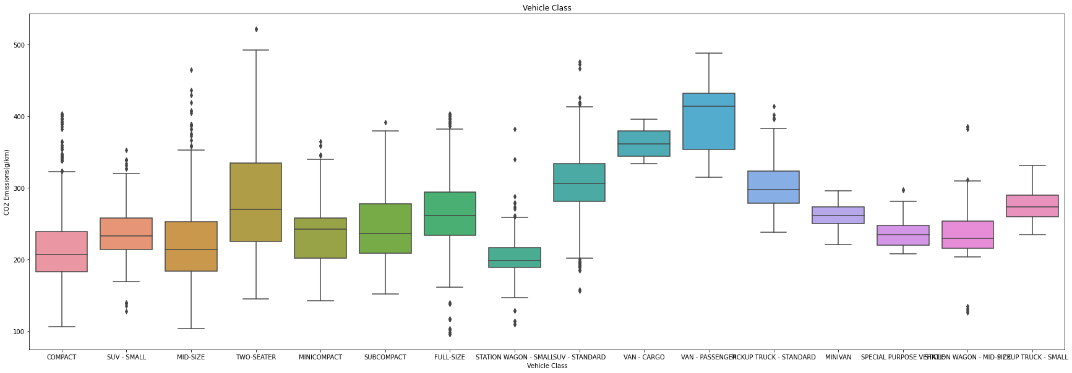

Slide 42
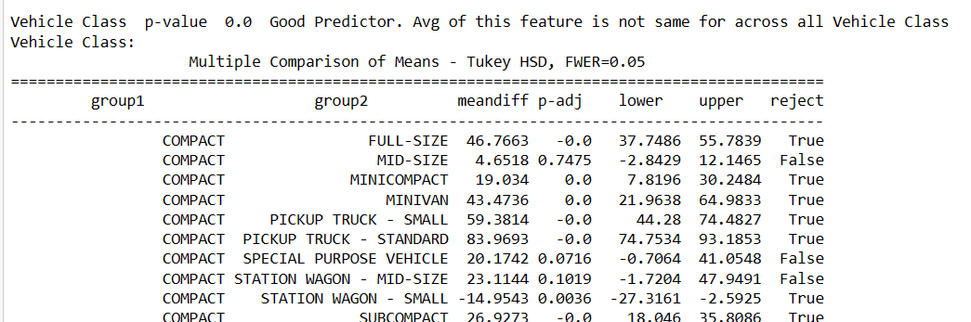

Slide 43
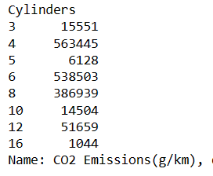
Total Co2 Emission by Cylinders

Slide 44
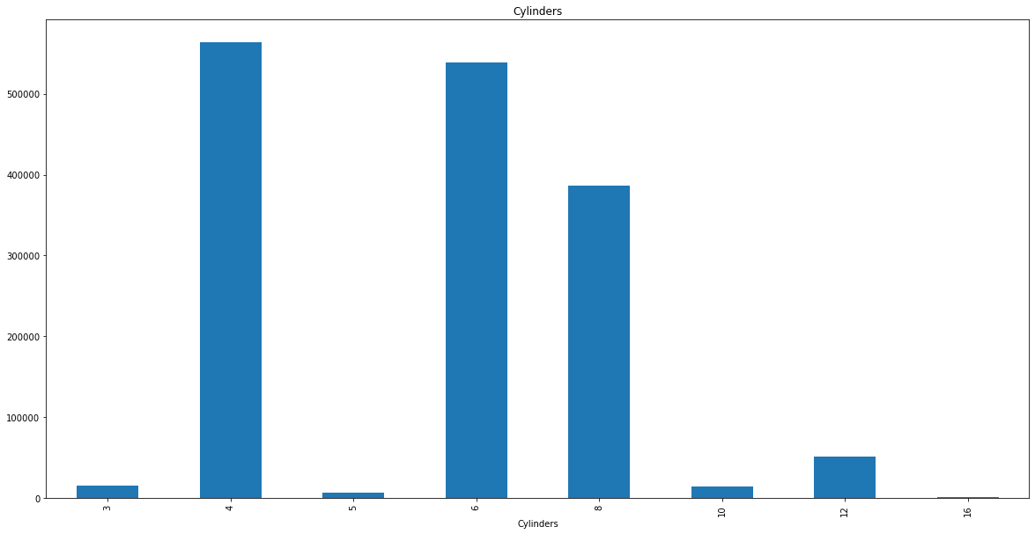

Slide 45
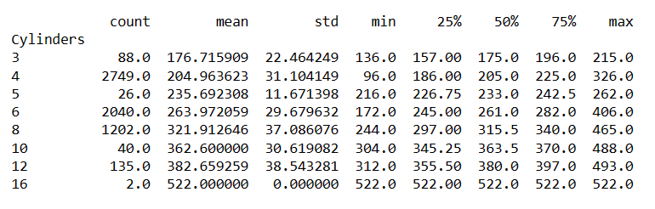

Slide 46
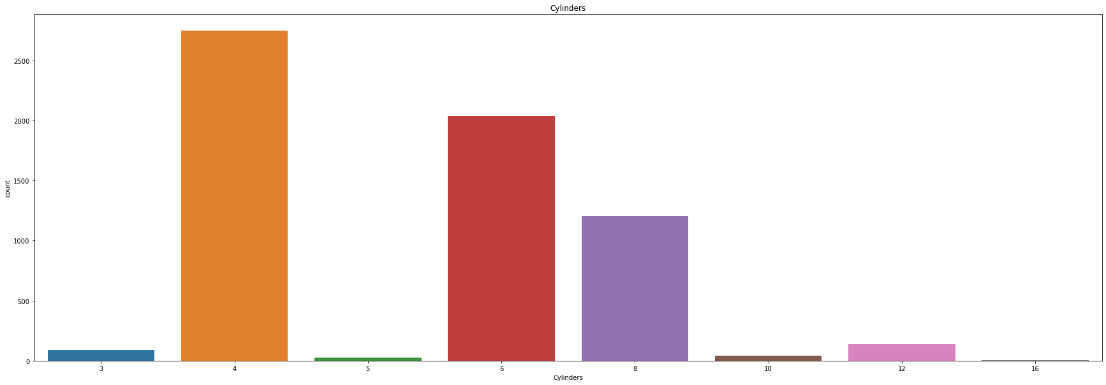

Slide 47
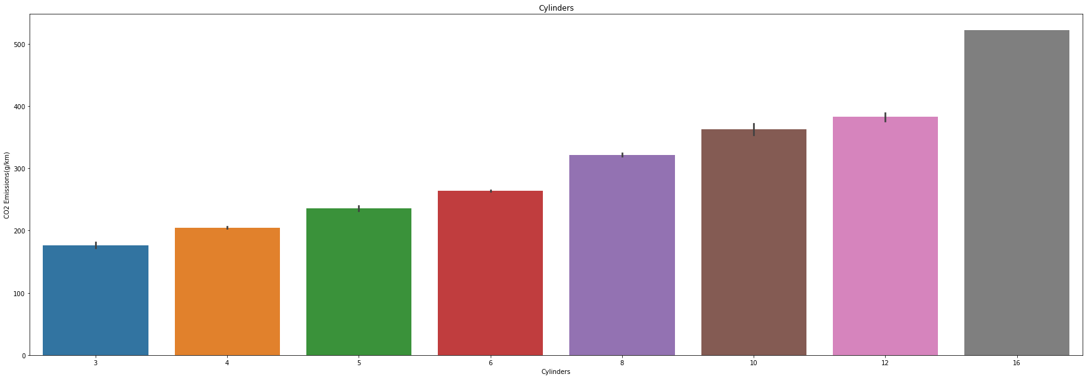

Slide 48


Slide 49


Slide 50

Total Co2 Emission by Transmission Type

Slide 51


Slide 52


Slide 53


Slide 54
# Vehicle Class
# We can see that highest amount of Co2 is contributed by SUV Small and Std Vehicles along with Compact and Mid Size Cars.
# Significant amount of contribution comes from full-size vehicles, pick-up truck standard subcompact and two seater cars
# Interestingly, we can see count of SUV standard is not very high but contribution to Co2 Emission is quite high
# From the bargraph and boxplot we can see avg contribution to Co2 Emission by SUV- Std is quite high. Special Attention is required towards SUV-Std
# as count of SUV is significant but no very high but still it is one of the top contributors to Co2 Emission
# Cylinders
# We can see that highest amount of Co2 is contributed by 4 cylinders,followed by 6 cylinders and 8 cylinders
# The same pattern is followed in countplot. Special attention is required to improve 6 cylinders engines and count is significant
# but contributions to Co2 is almost same as 4 cylinders engines in total
# From the bargraph and boxplot we can see, avg contibution to Co2 Emission increases with number of cylinders
#Transmission
# Highest amount of contribution to Co2 Emission is by AS6 and AS8 type, followed by A6 and M6 type. Significant Contribution
# is also given by A8,AM7 and AS7
# Count of M6, AS6, A6, AS8 is also high. We can the Co2 Emission is more or less directly proportional to count.
# From Bargraph and Boxplot we can see the range of average Co2 Emission is small.
# AV7, AM6, M5, AV, AV6, AM5, AV10 avg Co2 Emission is less.

Slide 55
# Fuel_type
# Clearly X & Z fuel type have highest Co2 Emission in total.
# Again Co2 Emission in total is directly proportional to count. There is no anomally
# On an average Co2 Emission for all fuel type is same

Slide 56


Slide 57



Slide 58



Slide 59



Slide 60


Slide 61


Slide 62



Slide 63


Slide 64


Slide 65





